Slide 1



Bogdan GORELKIN M2-WET Compatibility between security and reliability mechanisms in IoT systems
Département Électronique et Technologies Numériques
Jury de soutenance:
Sebastien PILLEMENT
Maria MENDEZ REAL
Nantes 2020

Slide 2
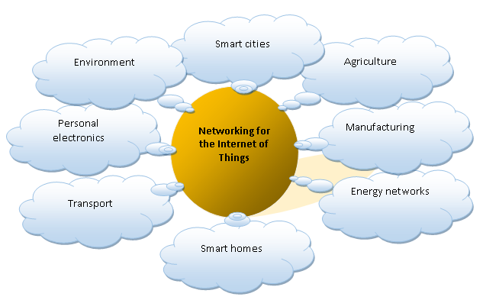
Application area
Smart cities – Parking, urban transport, lighting, etc.
Agriculture – Monitoring environmental parameters, inventory management, process automation, etc.
Manufacturing – Monitoring and control of technical processes
Energy networks – Accounting and monitoring, management of intelligent networks
Smart homes – Fire / security alarm, etc.
Transport – Fleet management, cargo tracking, etc.
Personal electronics – Health monitoring, location monitoring systems, etc
Environment – Monitoring of air condition, water bodies, etc.
1

Slide 3
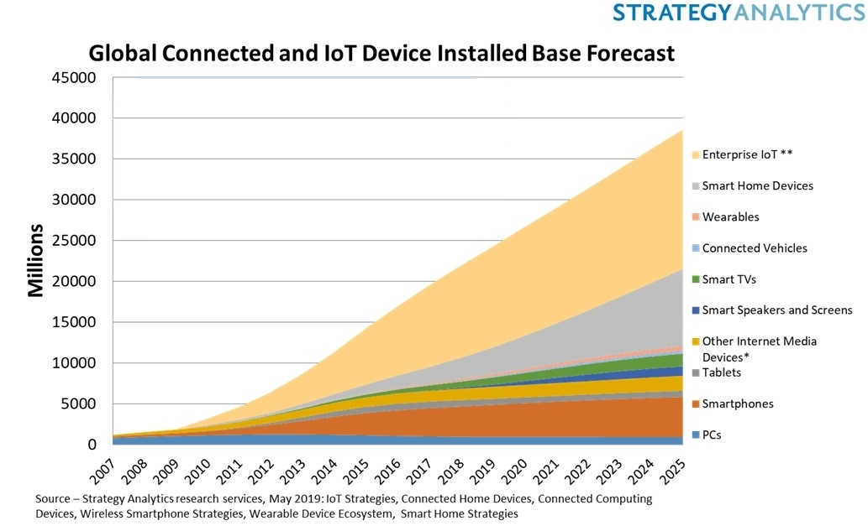
Introduction
The Internet of things (IoT) consists of complex sensors, actuators, and microchips embedded in physical objects around us world, making them smarter than ever. All these things are connected together and exchange huge data between them and with other digital components without any human intervention
The true innovation and potential of the Internet of Things is to transform business models, enable companies to sell products, bringing new benefits to both the company and the customer.
2

Slide 4
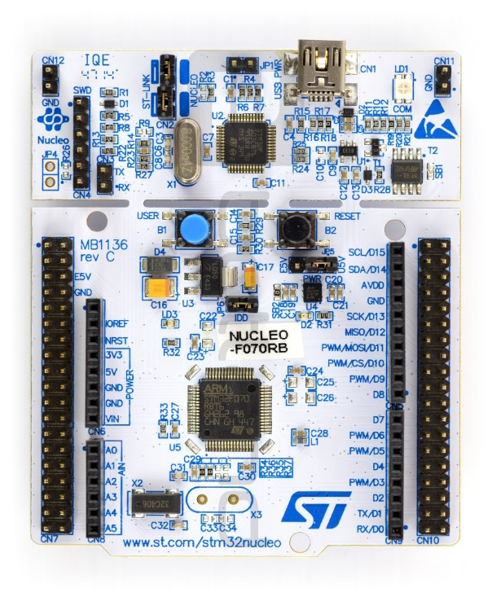
The aim of this work
study side channel attack on the RSA cryptographic algorithm using data from the built-in temperature sensor on the STM32F070Rb microcontroller on the Nucleo board
Tasks to achieve the goal
To consider threats to the security of the transmitted data
Parse the operation of the RSA algorithm
Explore the attacks through third-party channels
Implement the experimental setup
°C
°C
°C
Perform an RSA attack test through the temperature channel
°C
Analyze the results
3

Slide 5










Confidentiality transmitted / collected data
Confidentiality must guarantee data illegibility with unauthorized access
 | Еxamples | Algorithm basis on
Symmetric cryptographic mechanisms | AES | the difficulty of solving certain types of equations.
 | DES | on a combination of non-linear (S-blocks) and linear (permutations of E, IP, IP-1) converters.
 | GOST block cipher (Magma) | Fiestel network
Asymmetric cryptographic mechanisms | RSA | the complexity of factorizing semisimple numbers
 | Elgamal | the difficulties of computing discrete logarithms in a finite field
 | DSA | computational complexity of taking logarithms in finite fields.
4

Slide 6

Scope of public key cryptographic algorithms
R
S
A
Adleman
As independent means of protection of transmitted and stored data
Samir
As a means for distributing keys
Rivest
Means of user authentication
The basic principle of RSA encryption is built on large primes (p and q) and mathematical operations on them. In asymmetric, unlike symmetric, not one, but a pair of keys is generated: private is used to decrypt messages by the addressee and remains secret, and the public is transmitted to the addressee.
5

Slide 7
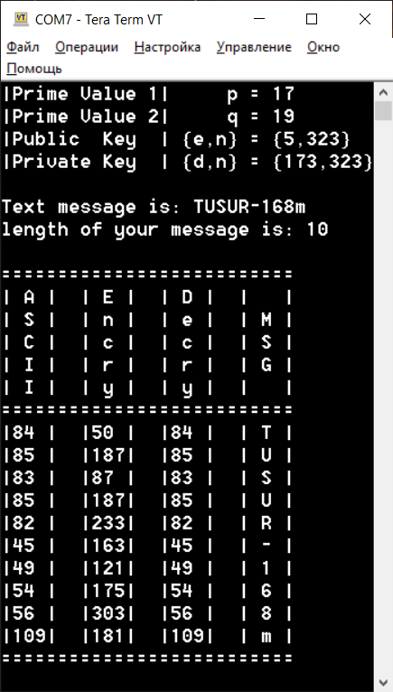
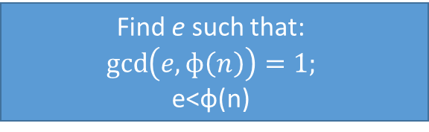
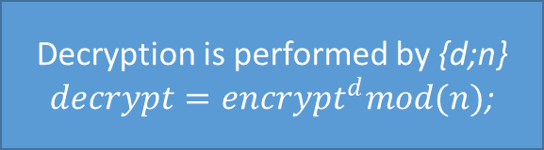
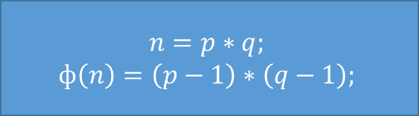
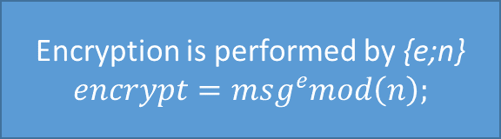
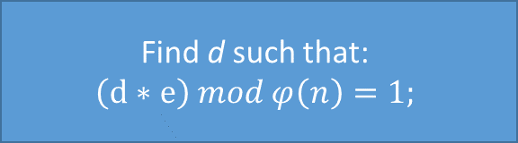
RSA work algorithm
Two random large prime numbers are selected 𝑝 and 𝑞
p = 17; q = 19;
are p and q simple?
no
yes
Find e such that:
$$\gcd\left(e,ф\left(n\right)\right)=1;$$
e<ф(n)
$$n=p∗q;$$
$$ф\left(n\right)=\left(p−1\right)∗\left(q−1\right);$$
Find d such that:
$$\left(d∗e\right) mod φ\left(n\right)=1;$$
Encryption is performed by {e;n}
$$encrypt={msg}^{e}mod\left(n\right);$$
Decryption is performed by {d;n}
$decrypt={encrypt}^{d}mod(n)$;
6

Slide 8
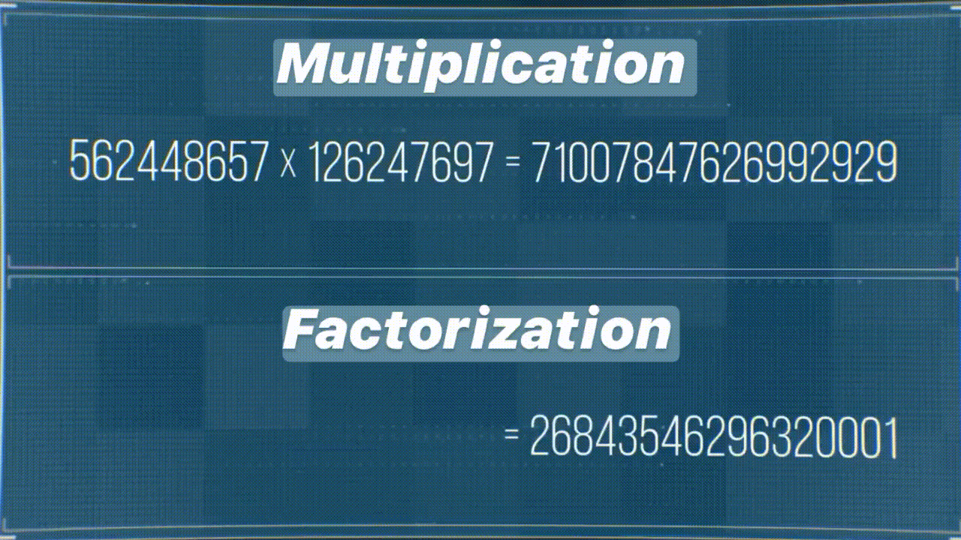
Cryptographic strength of RSA
lg n | Number of operations | Notes
50 | 1.4*10¹⁰ | Disclosed on supercomputers
100 | 2.3*10¹⁵ | At the limit of modern technology
200 | 1.2*10²³ | Beyond Modern Technology
400 | 2.7*10³⁴ | Requires significant technology changes
800 | 1.3*10⁵¹ | Not disclosed
According to the recommendations of the authors of the RSA algorithm, the sizes of module n are selected according to the following criteria:
768 bits - for individuals;
1024 bits - for commercial information;
2048 bits - for classified information.
7

Slide 9
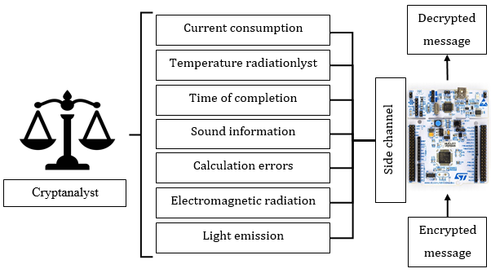
Side Channel Attacks (SCA)
are aimed at the vulnerability of the cryptosystem in its practical implementation
8

Slide 10
Side Channel Attacks (SCA)
Computing process control
Passive - the attacker receives information without noticeable impact on the system
Active - the attacker acts on the system, as a result of which its behavior changes
Analysis Method Used
Simple SCA - study of the direct relationship between the processes in the device and the information received
Differential SCA - use statistical methods to study the dependence of input data on information obtained through a third-party channel
System Access Method
Invasive - opening the system with a cryptanalyst and gaining direct access to internal components
Semi-invasive - impact on internal components occurs without direct contact with the device
Non-invasive - without affecting the system under study, only externally available information is used
9

Slide 11
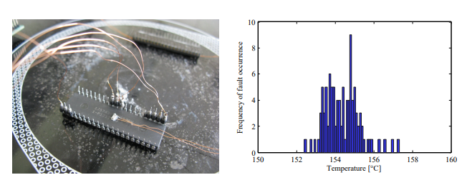
Temperature attacks
When implementing cryptographic device algorithms
store the secret key in non-volatile memory and, if necessary, load it into SRAM. This key is always loaded into the same memory location in SRAM, because software code or hardware implementation is usually specified and cannot be changed.
Distribution of fault occurrence between 150 and 160 ◦C. Mean faultinduction temperature is 154.4 ◦C.
*Hutter M., Schmidt M. (2014). The Temperature Side Channel and Heating Fault Attacks. Cryptography ePrint Archive, 190
10

Slide 12
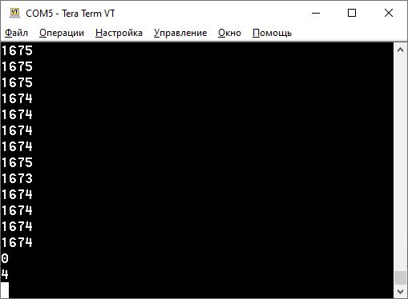
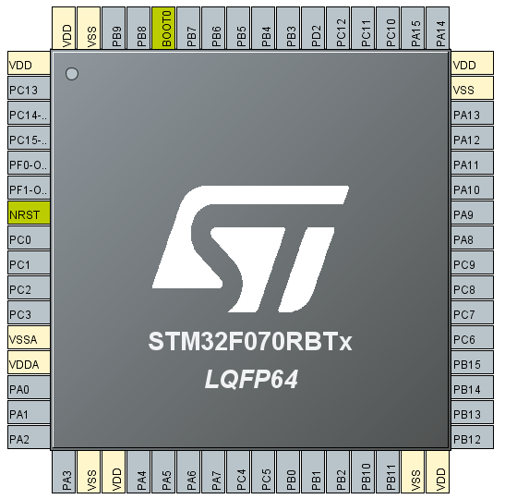
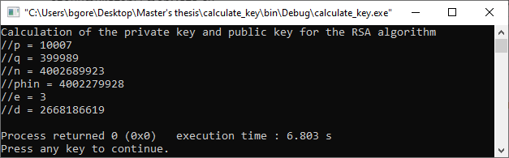
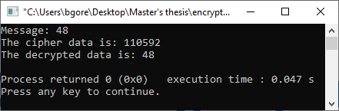
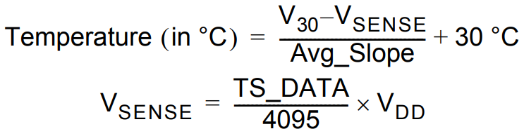
Obtaining experimental data
Steps
Calculated a public and private key
Received an encrypted message and performed the decryption on the stm32 microcontroller
Decrypted the same message on stm32
received the measured voltage from the internal temperature sensor stm32 by DMA (TS_DATA)
11

Slide 13
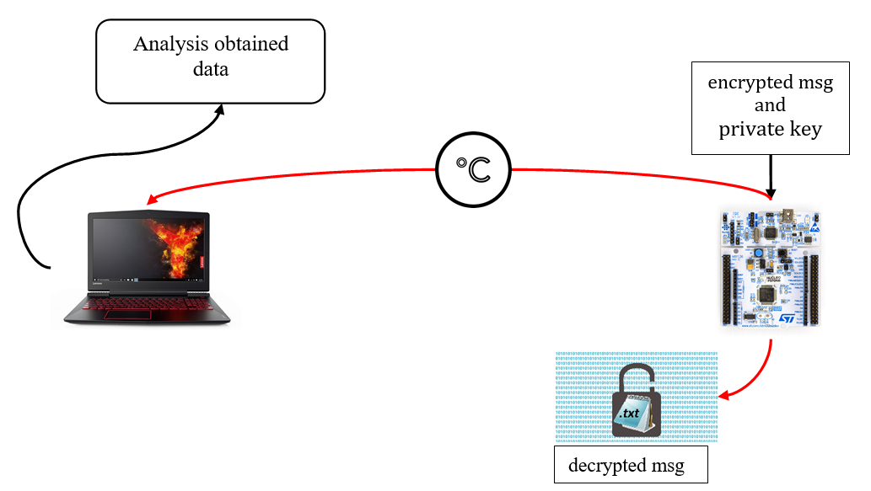
Experimental setup
12

Slide 14
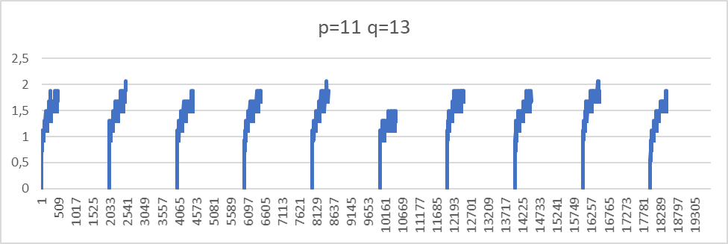
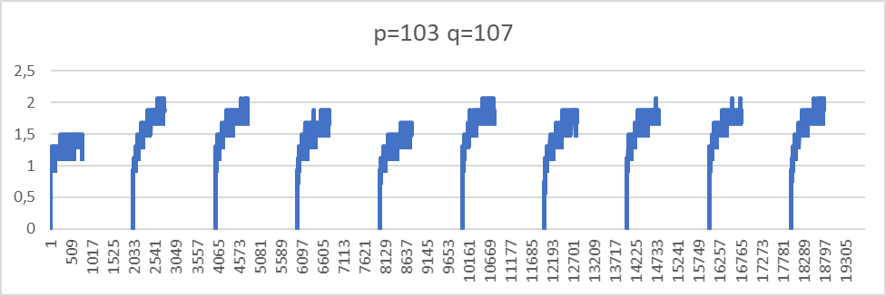
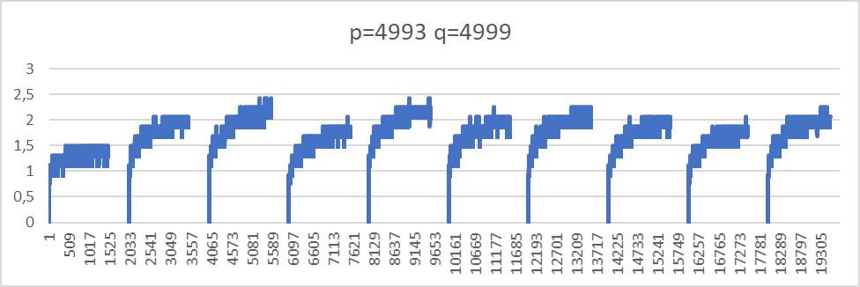
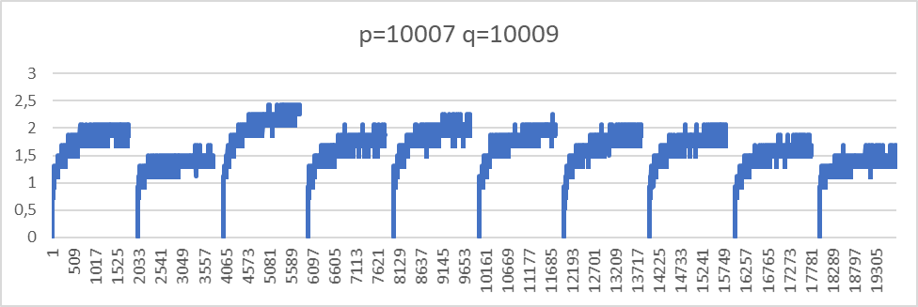
Temperature plots
Experiment |  | 1 | 2 | 3 | 4
p |  | 11 | 103 | 4993 | 10007
q |  | 13 | 107 | 4999 | 10009
n |  | 143 | 11021 | 24960007 | 100160063
φ(n) |  | 120 | 10812 | 24950016 | 100140048
e |  | 7 | 5 | 5 | 5
d |  | 103 | 4325 | 19960013 | 60084029
Symbol | ASCII | Encrypted data
0 | 48 | 126 | 9469 | 5203898 | 54483842
1 | 49 | 36 | 7019 | 7915172 | 82155123
2 | 50 | 41 | 10566 | 12979916 | 12019811
3 | 51 | 116 | 1825 | 20545160 | 44545062
4 | 52 | 13 | 1574 | 5803927 | 79723843
5 | 53 | 92 | 3648 | 18835381 | 17555241
6 | 54 | 76 | 8122 | 9884898 | 58524772
7 | 55 | 55 | 10410 | 4084235 | 2484060
8 | 56 | 56 | 1385 | 1611622 | 49931461
9 | 57 | 73 | 562 | 2651889 | 731679
0
1
2
3
4
5
6
7
8
9
0
1
2
3
4
5
6
7
8
9
0
1
2
3
4
5
6
7
8
9
0
1
2
3
4
5
6
7
8
9
13

Slide 15
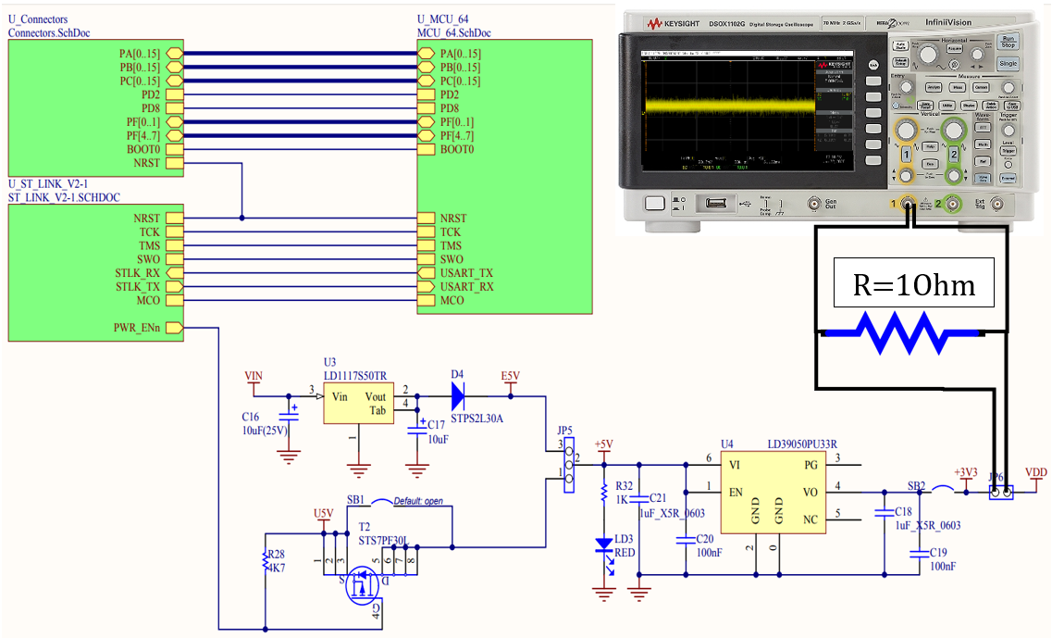
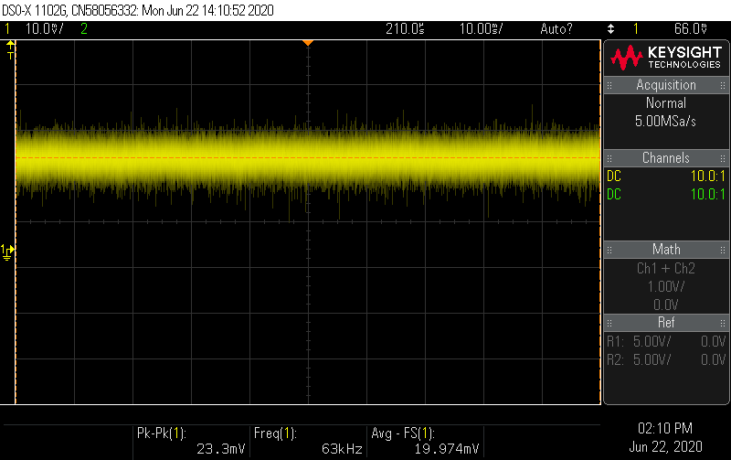
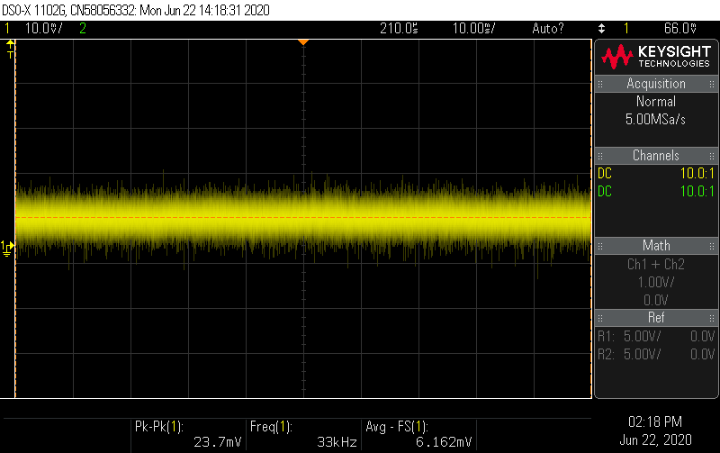
Сurrent consumed by the microcircuit
14

Slide 16

Conclusion
With the hardware implementation of any cryptographic device, even with the most mathematically complex cryptographic algorithm, it is impossible to avoid information leakage through side channels. However, this information can be made illegible and prevent unauthorized access. So, the built-in temperature sensor can be used not only for personal gain, but also to prevent unauthorized access. You can add a security algorithm to the cryptographic device, which works when the temperature changes, when the probability of extracting encryption keys increases.
The vulnerability of RSA, at the moment, is caused not by the algorithm, but by its practical implementation. When using large keys, from a mathematical point of view, a large amount of effort and resources is required to factorize a semisimple number. However, the use of third-party data that occurs during the execution of the algorithm on the device can allow an attacker to extract useful information and obtain encryption keys of even the most complex algorithm.
Active attacks on the temperature channel have already been investigated [27]. With active attacks, it was possible to successfully retrieve the RSA encryption keys based on erroneous calculations. A 2014 study by Michael Hutter and Jorn-Marc Schmidt used an external temperature sensor that compromised processor integrity. Using built-in temperature sensors for such attacks can be more promising, as visually the integrity of the device will not be compromised.
In general, it must be emphasized that security solutions for Internet of Things are not yet fully understood. With the development of technology and its role in the modern world, it is necessary to continue scientific research and propose modern solutions that can improve the situation in the field of security of the Internet of things.
15

